Slide 1
Night Photography
With
Lynn Thompson

Slide 2
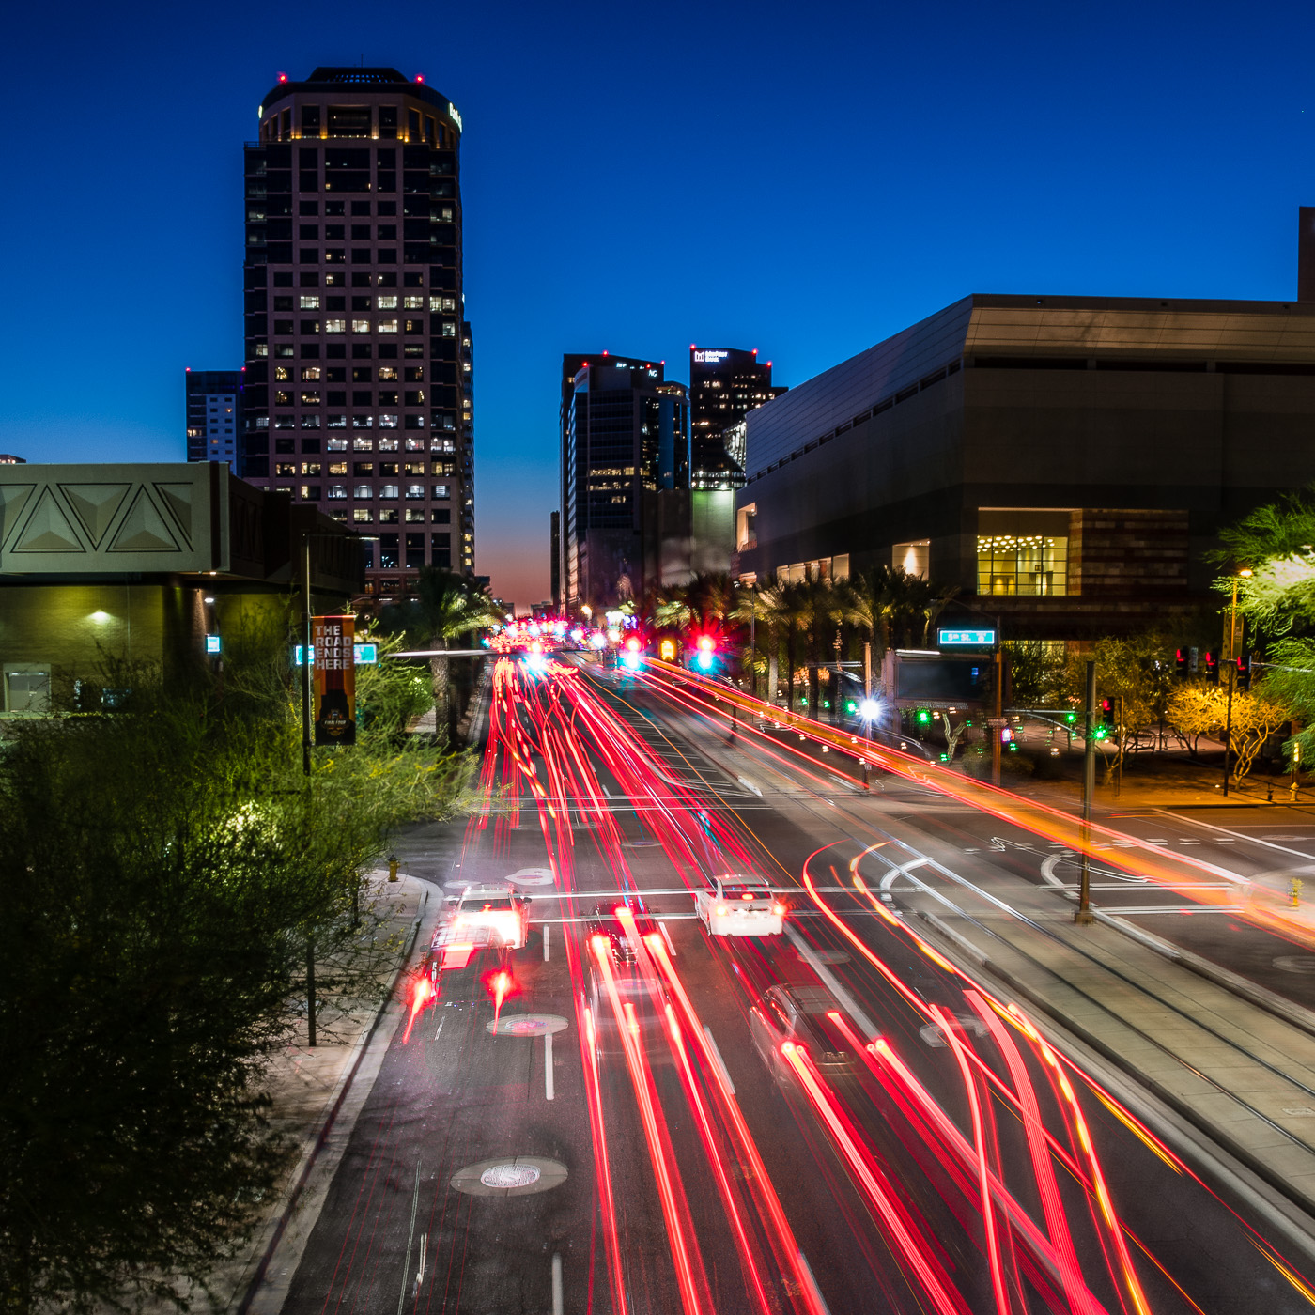
Why Photograph with no Light?
Sunburn is not a problem.
Familiar Places are not the Same.
We Enjoy a Challenge
It is a Unique Look

Slide 3
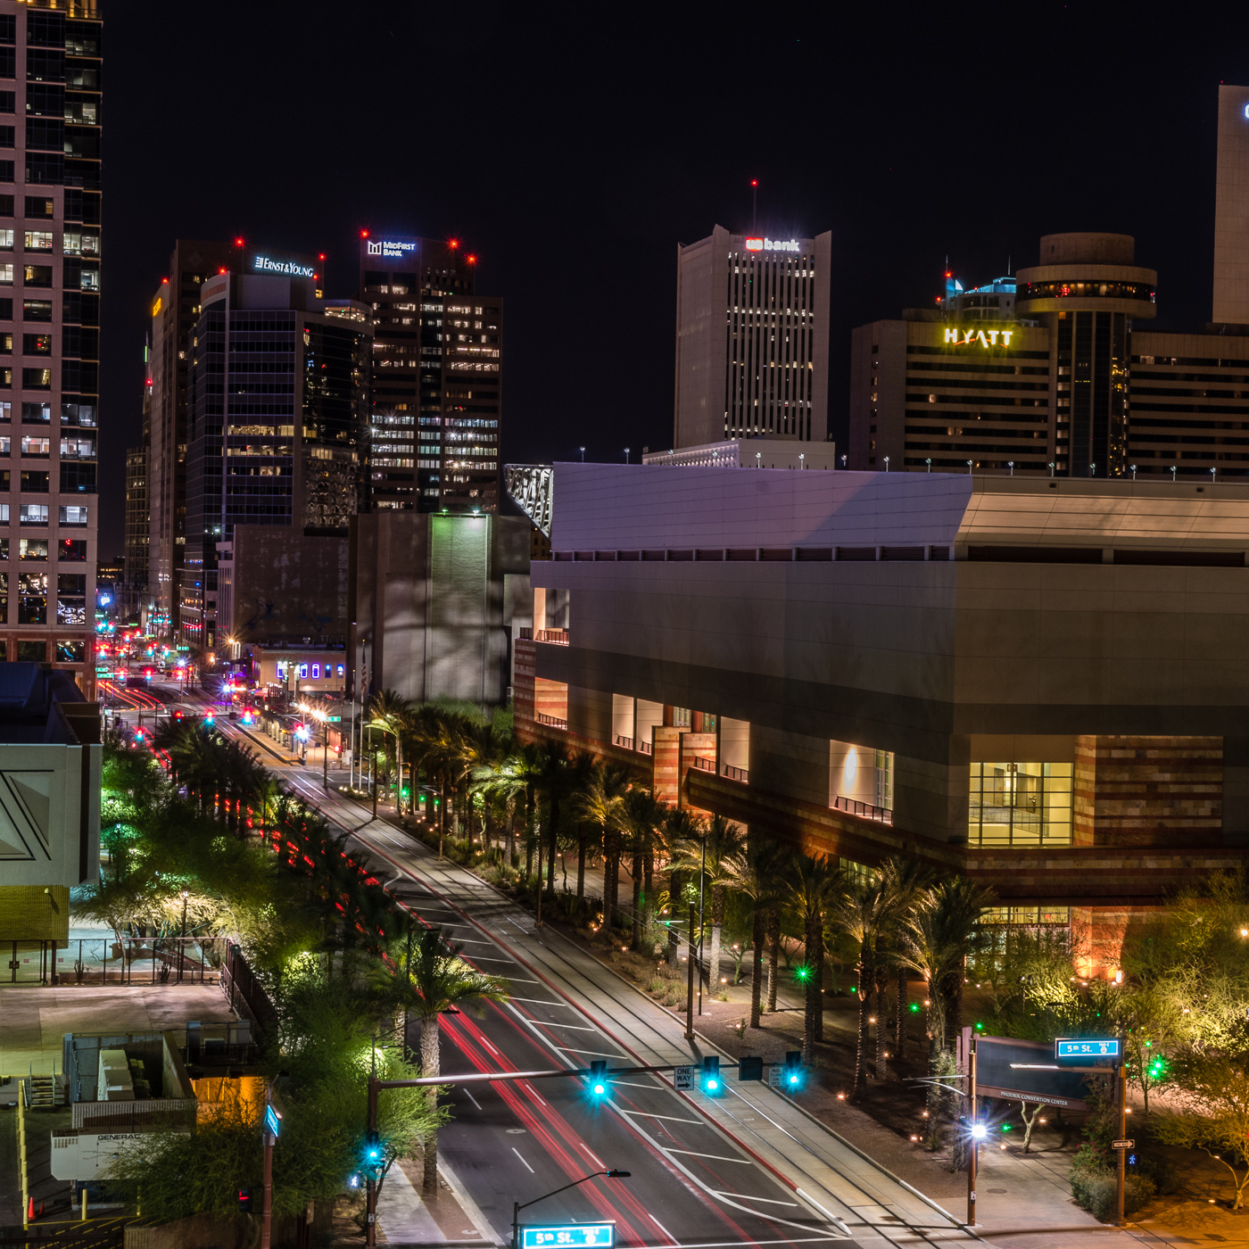
Problems with Night Photography
You must know your camera very well.
Hard to find controls in the dark.
Difficult to focus at night.
Find infinity focus in the light and tape your lens down.
Be patient.
Respect those around you. Ambient light from your flashlight can ruin their photos.

Slide 4
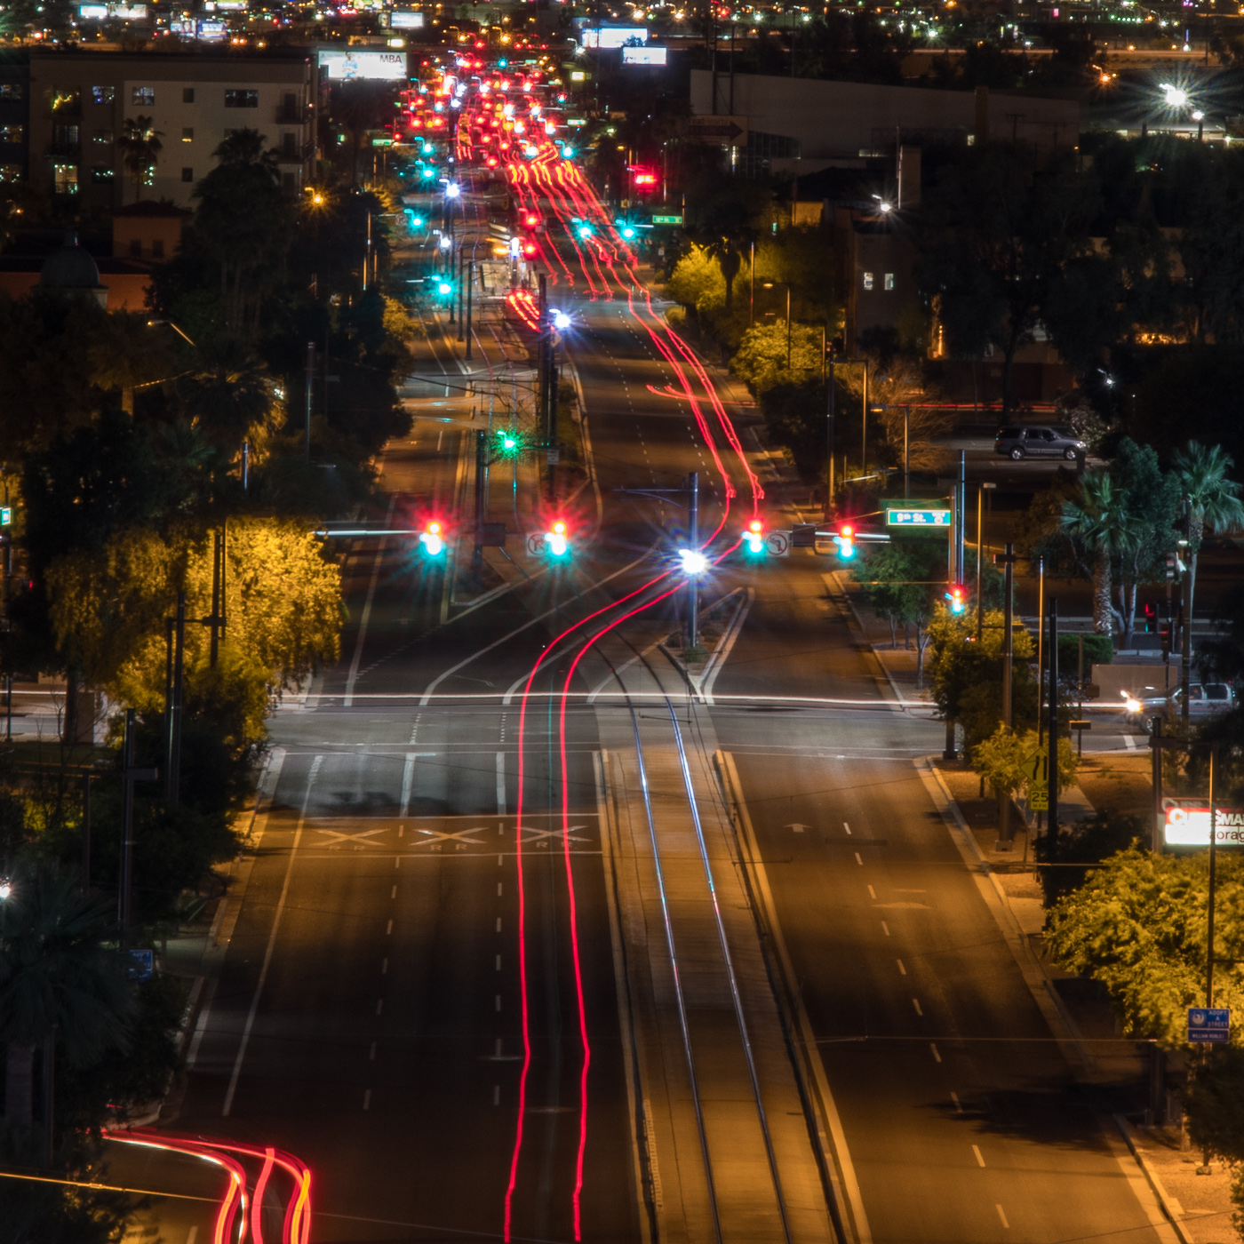
Equipment
DSLR or Mirrorless Camera with Bulb Setting.
Lens, the faster the better. Wide often best for landscapes.
Tripod.
Cable Release. Intervalometer is better.
Small flashlight with red mode.
Smart phone or some way to time an exposure beyond 30 seconds for star trails.
Chair. (I’m lazy)
Proper clothes, it can get cold at night.

Slide 5
Camera Setting
Shoot raw.
Auto white balance. Some recommend 3500K or Daylight.
Manual mode.
Focus at infinity and tape the lens down with gaffers tape.
Turn off long exposure noise reduction, VR, and image stabilization.
No filters on your lens.
Cable release if available.

Slide 6
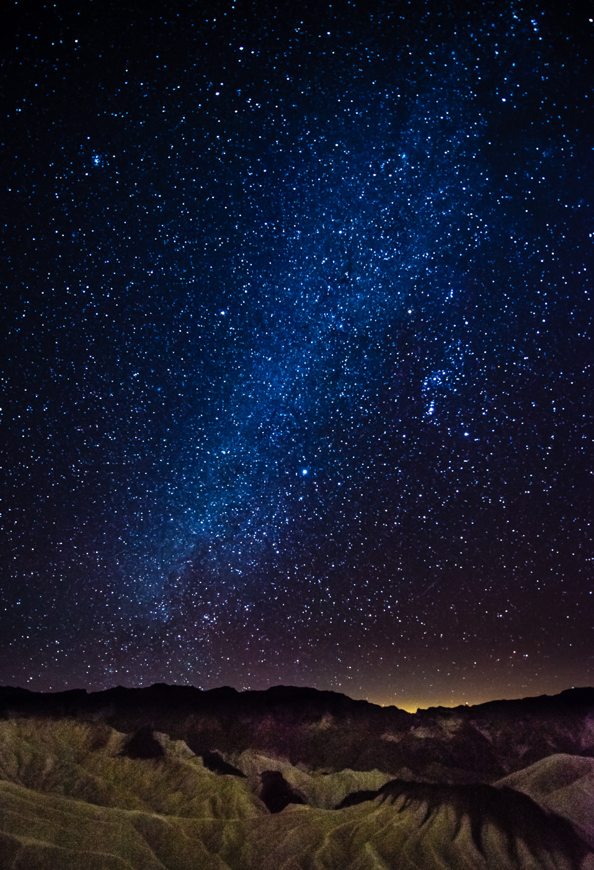
Stars as Points of Light
Works best with fast lens and camera that records at high ISO settings.
The 500 Rule. Divide the focal length of your lens into 500 to get the shutter speed before before the stars start to “trail.”
500 divided by 24 mm lens equals 20 seconds.
500 divided by 35 mm lens equals 14 seconds.
500 divided by 14 mm lens equals 36 seconds.
Longer lens means a shorter shutter speed before the stars begins to blur.
My basic starting point for a 24 mm lens is f2.8, 20 seconds, ISO 3200.
If your fastest lens is f4, use the same settings but you may need to adjust the ISO to 6400.

Slide 7
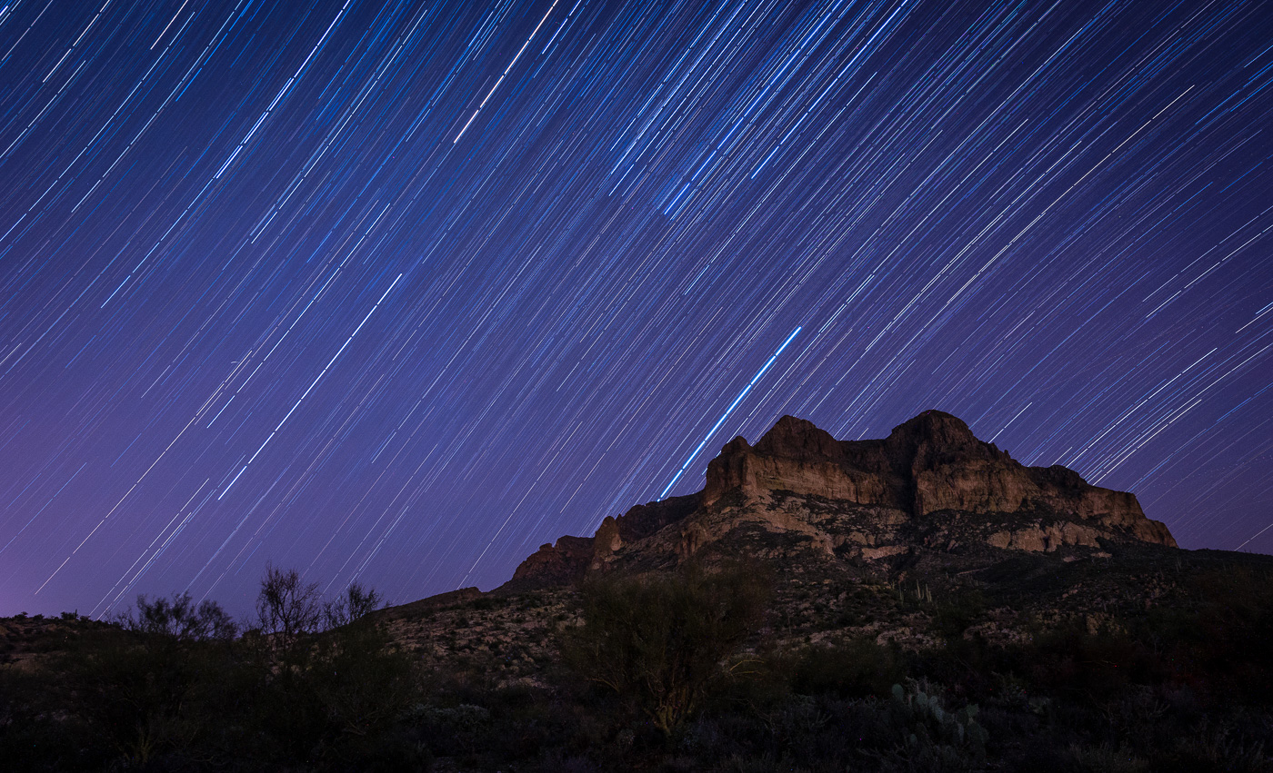
Shooting Star Trails
Stars standstill but the earth rotates leaving the illusion that the heavens are moving.
One option is to use a very long shutter speed of 60 minutes or more. Sensor heats up causing noise.
Second option is to shoot multiple shorter exposures and combine them in PS or some other software. I use 6 to 10 minute exposures. I like a minimum of ten 6 minute exposures.
Use a high ISO test shot.
Manual mode.
ISO 6400 at 1 second.
1 second at ISO 6400 equals 1 minute at ISO 100. Easy?
My base is ISO 400, f5.6, 10 minutes.

Slide 8
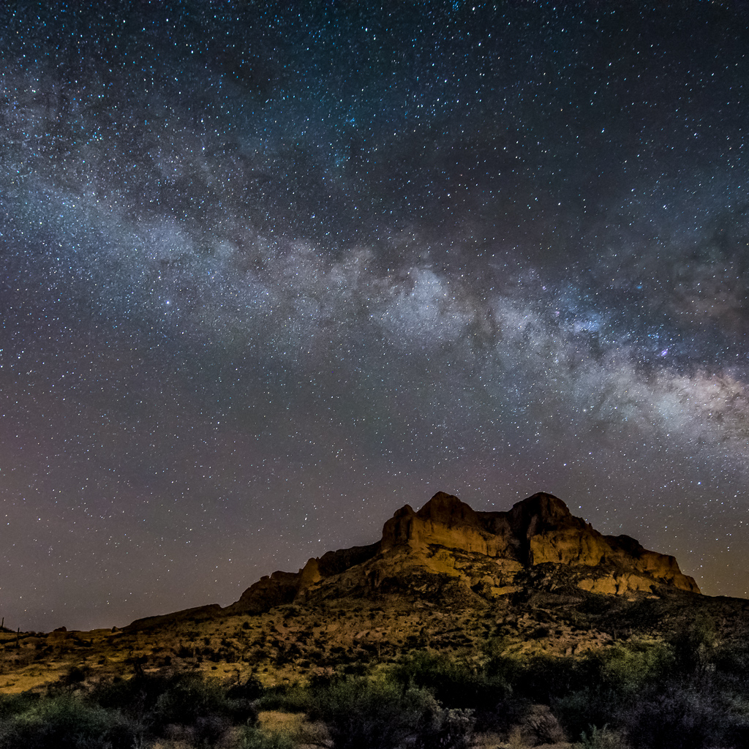
“Milky Way over Picket Post Mountain”
Shot at:
ISO 6400
F2.8
20 Seconds
14 MM lens, full frame camera
April 18, 2015
Between 9:00 and 10:00 PM

